Slide 1
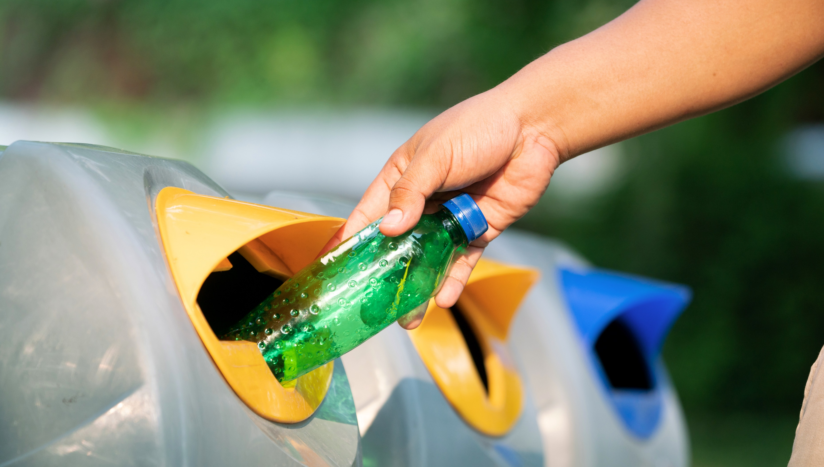
Sampson County Recycling
2025

Slide 2
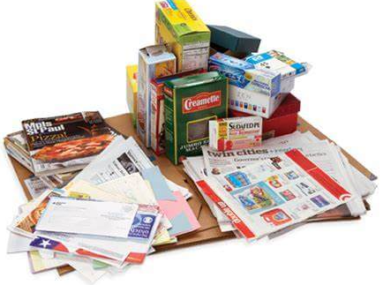
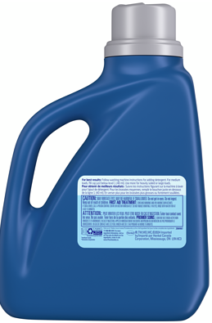
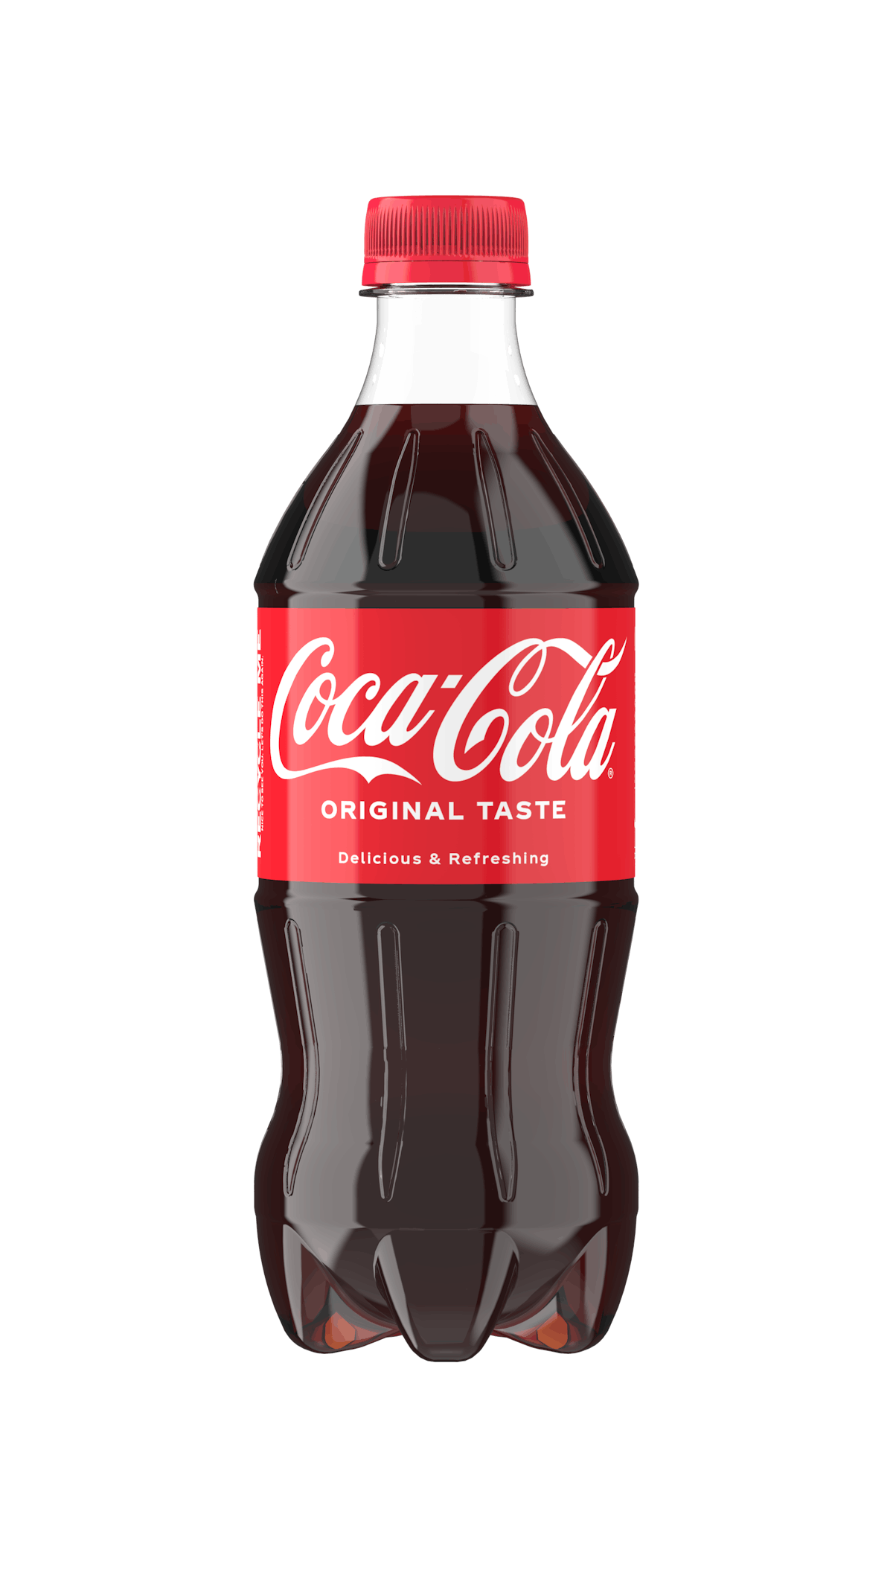
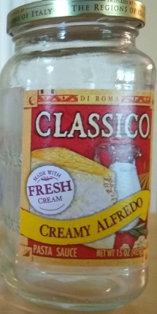
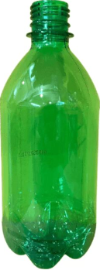
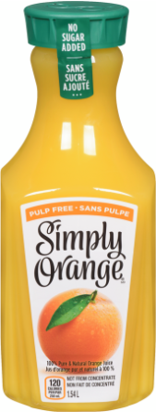
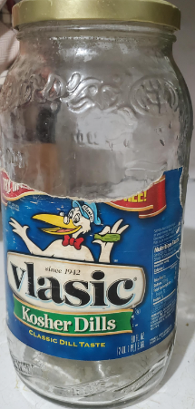
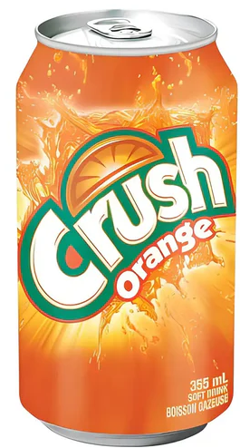
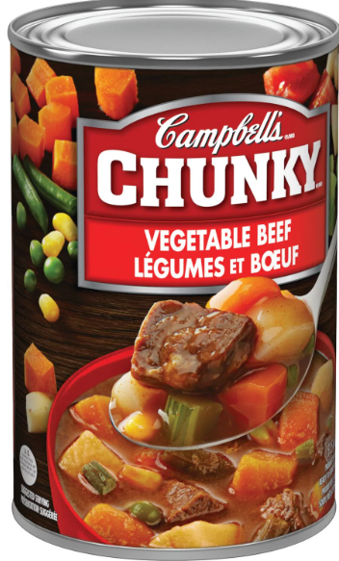
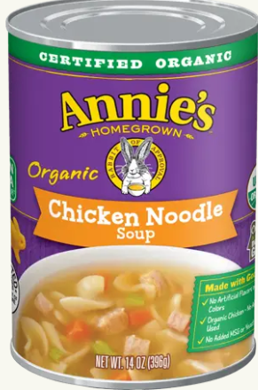
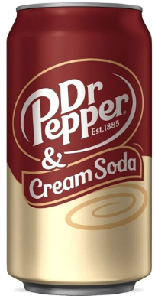
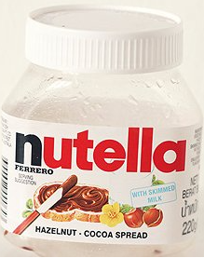
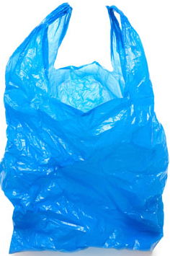
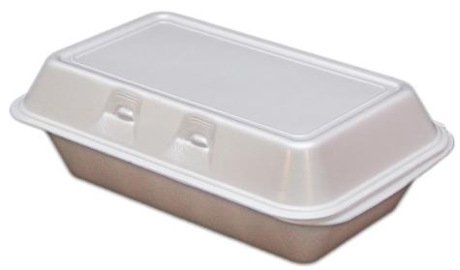
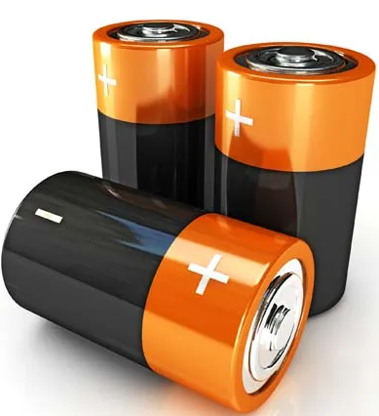
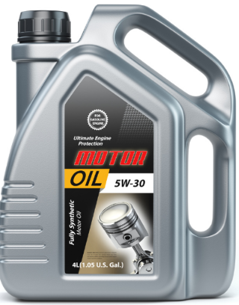
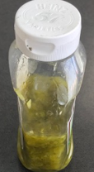
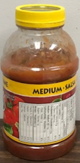
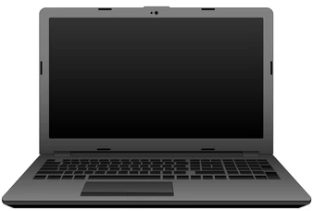
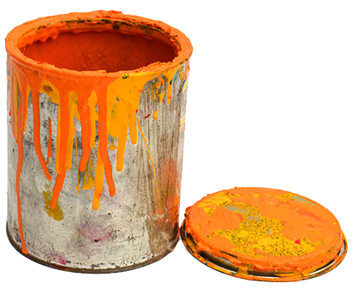
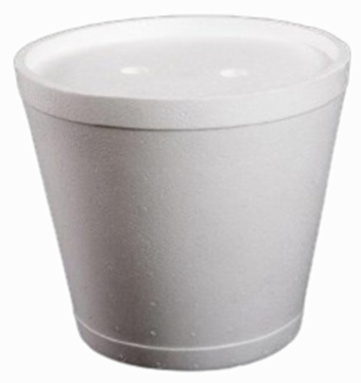
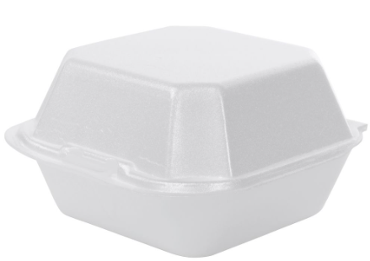
Accepted and Not-Accepted Items Materials in Sampson County
Accepted in Recycling Bins
Paper
Plastic
Cans
Glass
Paper, Newspaper, Magazines, and Cardboard
Plastic Bottles, containers, and Jugs
Aluminum, Steel and Tin Cans
Bottles and Jars
Not Accepted in Recycling Bins
No plastic bags or plastic wrap
No foam packaging
No contaminated containers
No batteries, including rechargeable batteries
No electronics including laptops, cell phones, vape pens, etc.
No hazardous waste including motor oil containers, aerosols, paint cans, propane tanks, etc.

Slide 3
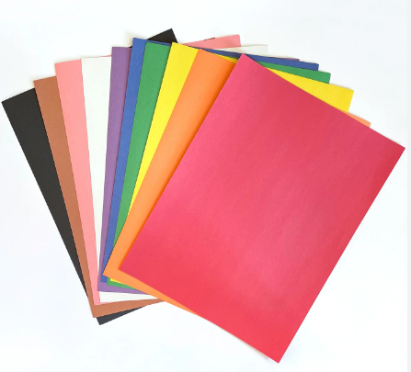
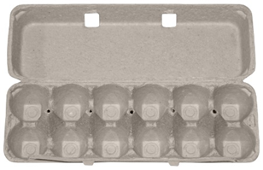
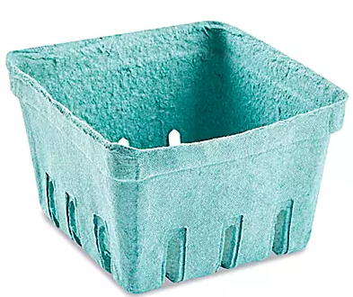
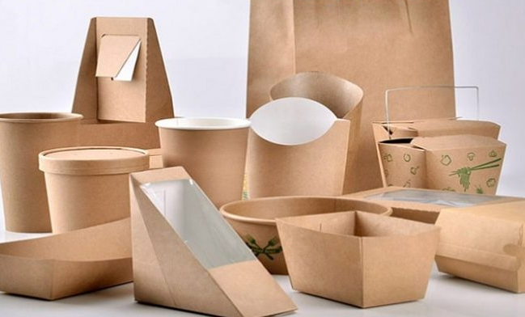
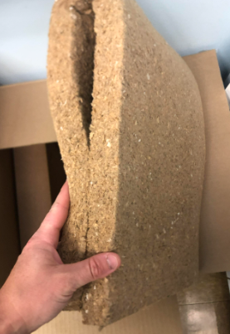
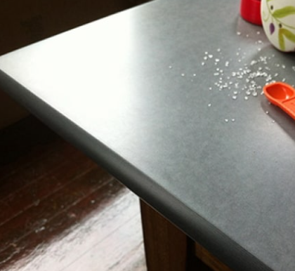
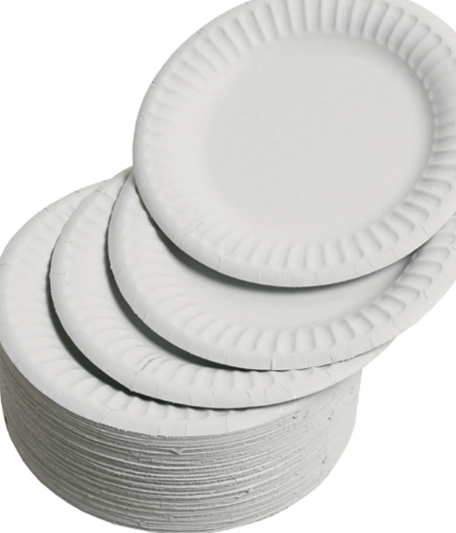
Newspaper
Recycled newspaper can be turned into paper plates, paper towels, and even new newspapers.
Egg cartons
Berry cartons
Construction paper
=
Building insulation
Paperboard packaging
New newspaper
Newspaper
Paper plates
Sheetrock
Countertop

Slide 4
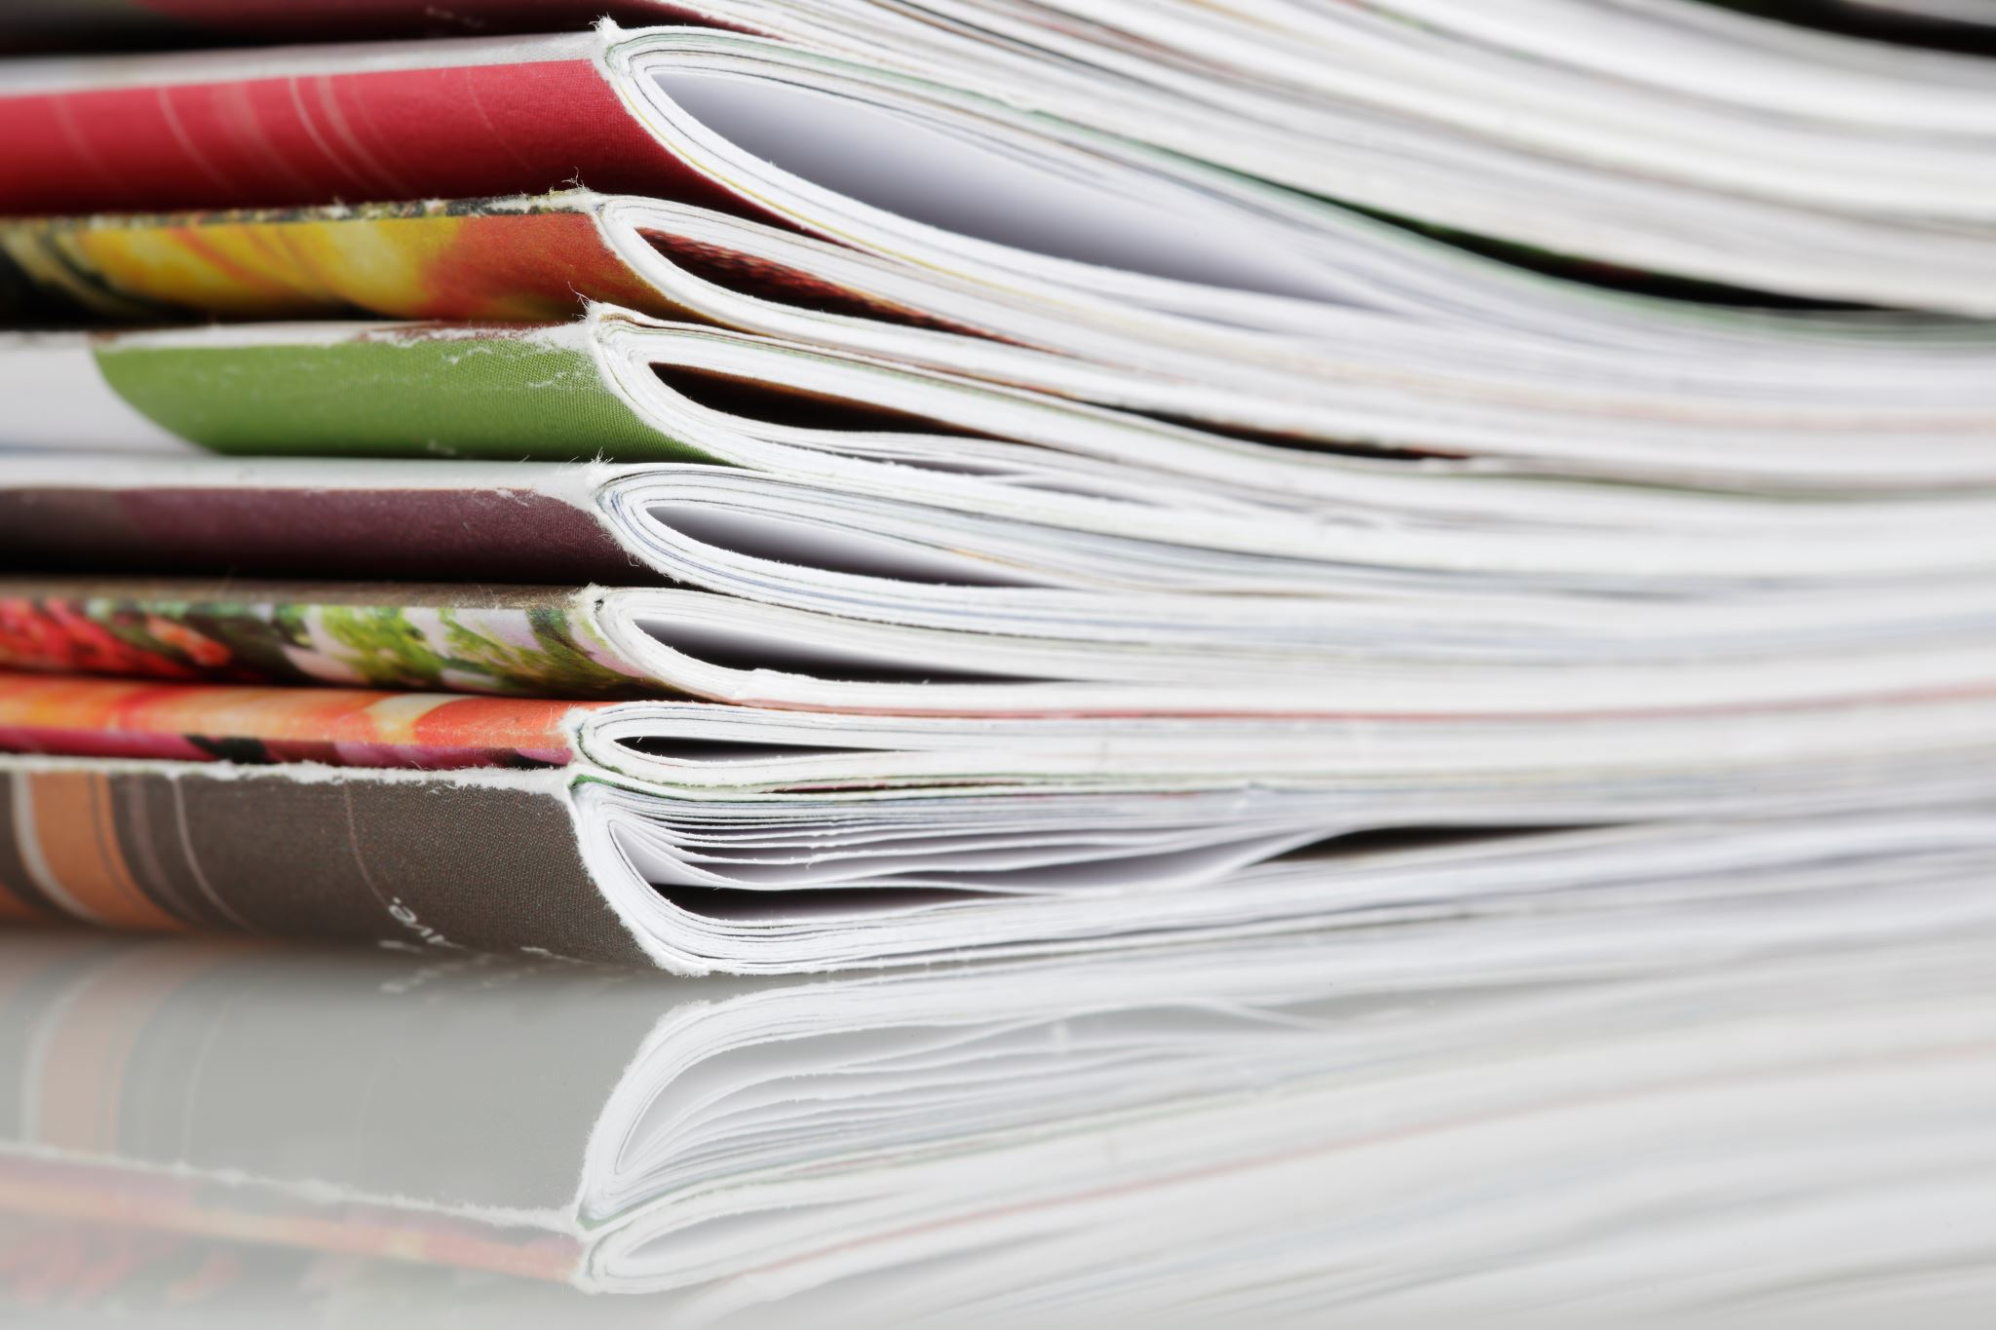
Magazines
The high clay content in magazines helps remove inks from paper, which can then be made into new paper products.
=
Paperboard packaging
New newspaper
Magazines

Slide 5
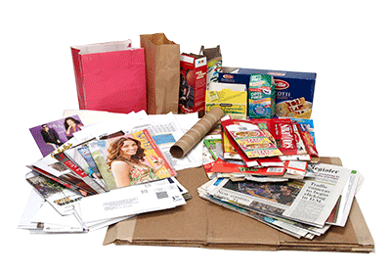
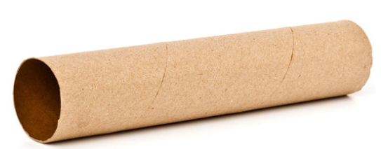
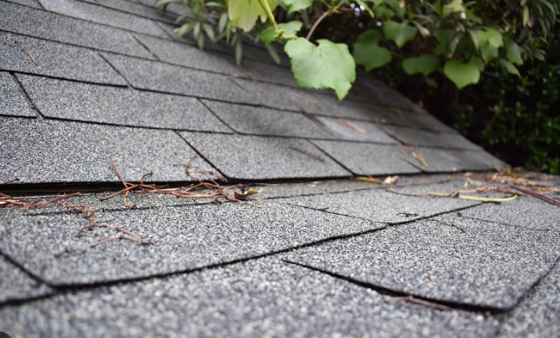
Paperboard / Mixed Paper
Paperboard is often used to make containers like cereal boxes, shoe boxes, and pasta boxes.
=
New paperboard packaging
Paper towel rolls
Paperboard (pasta boxes, mail, etc.)
Paper backing on roofing shingles

Slide 6
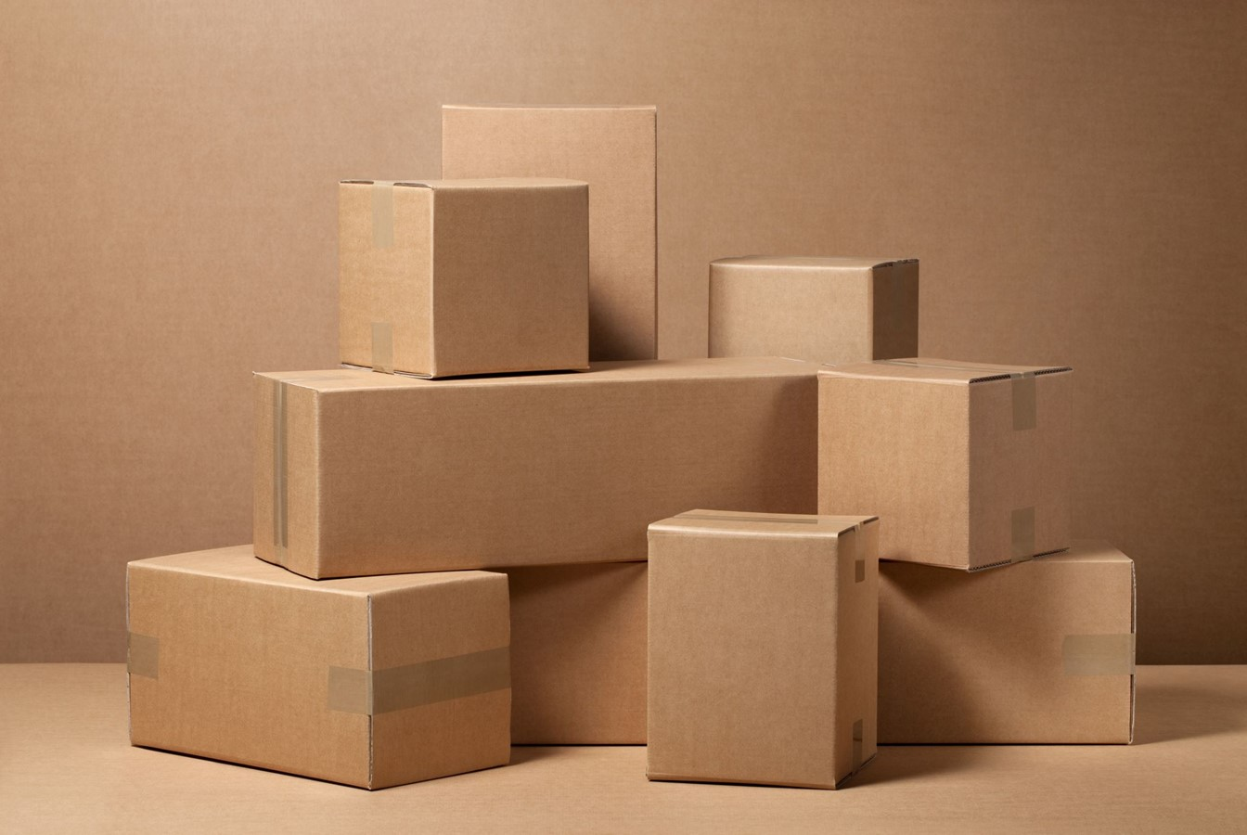
Corrugated Cardboard
Recycled cardboard is frequently used to make new cardboard products
=
Paperboard packaging
Paper bags
New cardboard
Cardboard

Slide 7
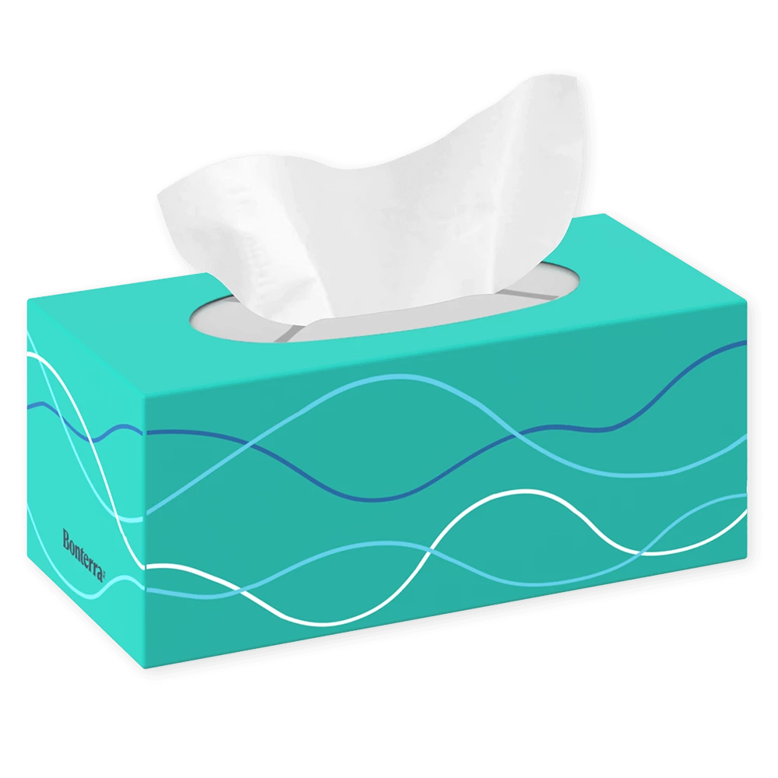
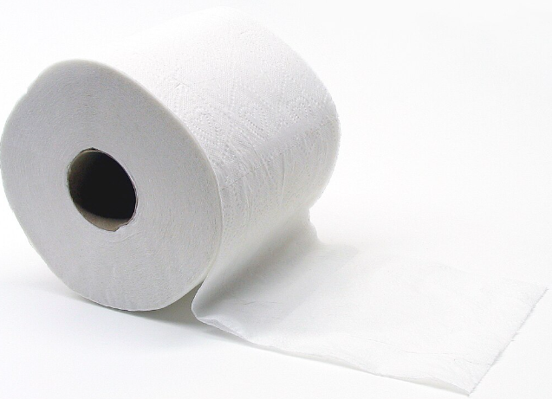
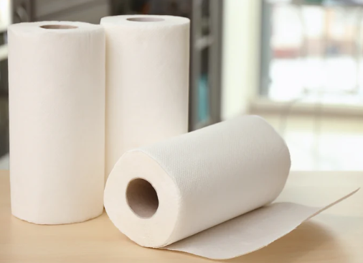
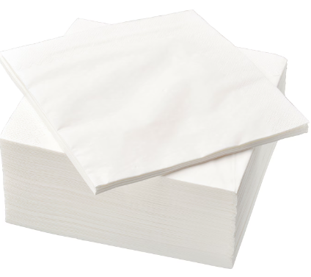
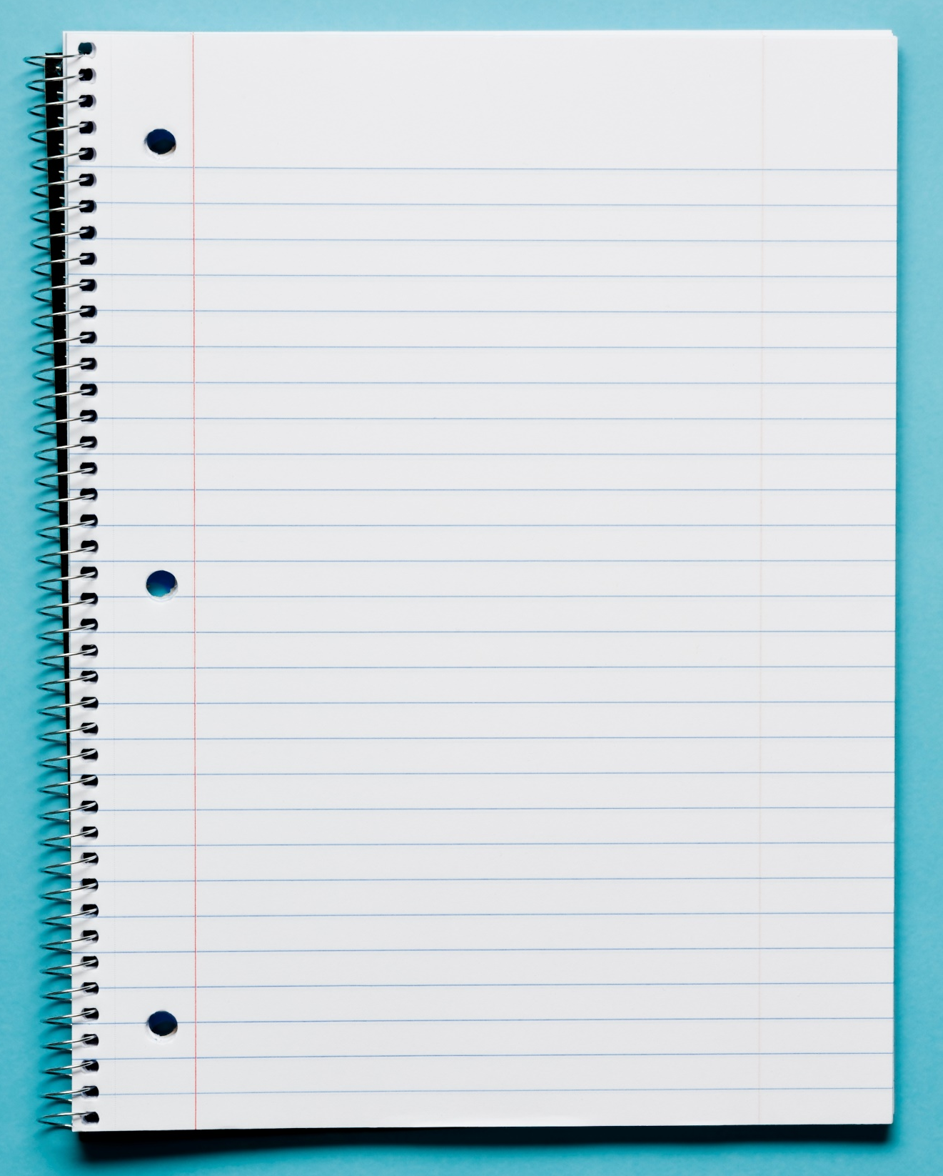
Office Paper
Office paper can be recycled into new office paper or other paper products such as paper towels, napkins, and toilet paper.
=
Tissues
Toilet paper
New computer paper
Office Paper
Paper towels
Napkins
New notebook paper

Slide 8
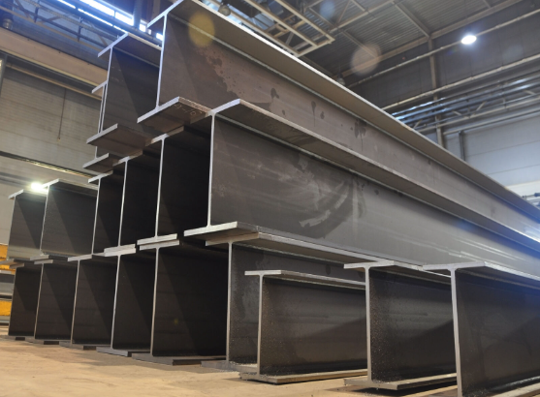
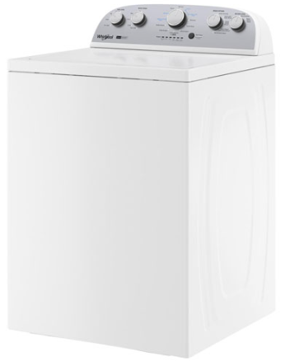
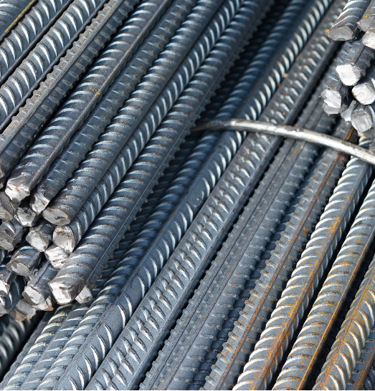
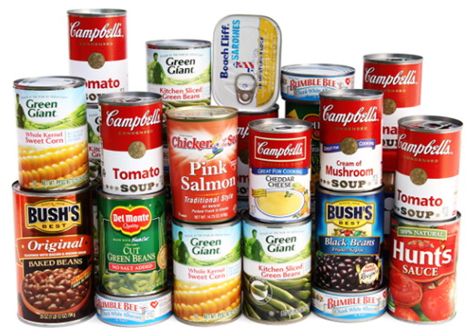
Steel/Tin Cans
Metal cans are separated into steel and tin, with the steel being used in construction materials and new cans.
=
Bike parts
Car parts
Steel beams
Metal cans
Rebar
Appliances
New cans
1. “Tin" cans are actually steel cans coated in a thin layer of tin. The tin and steel are separated during the recycling process. All steel contains recycled steel. Source: https://www.maine.gov/dep/waste/recycle/whatrecyclablesbecome.html#cardboard

Slide 9
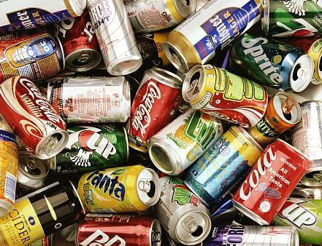
Aluminum Cans
These can be recycled into new aluminum cans, car bodies, or even airplane parts. Unlike other materials, aluminum can be recycled indefinitely without losing quality, which is why recycled cans are often turned back into new cans. Producing new cans from recycled aluminum saves 95% of the energy used to produce cans from ore, known as bauxite.¹
=
New aluminum cans
Aluminum Cans
1. Source: https://www.maine.gov/dep/waste/recycle/whatrecyclablesbecome.html#cardboard

Slide 10
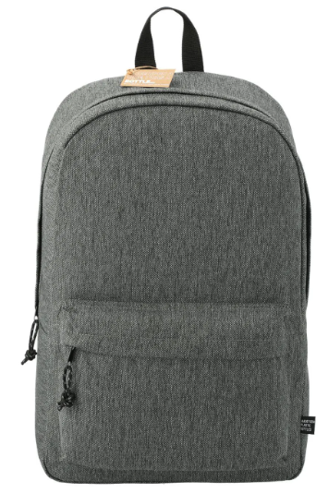
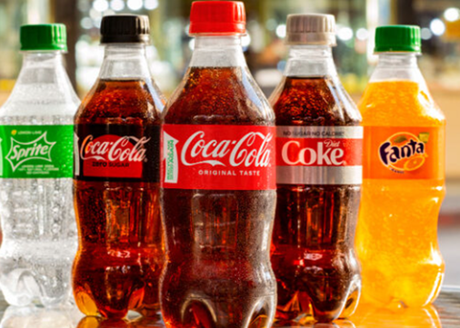
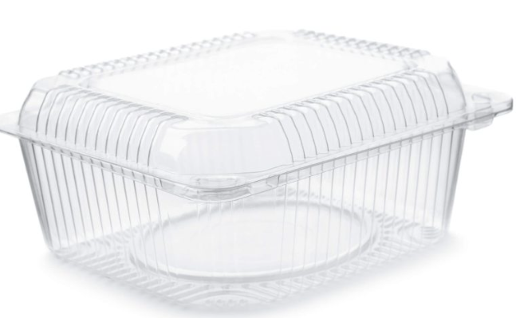
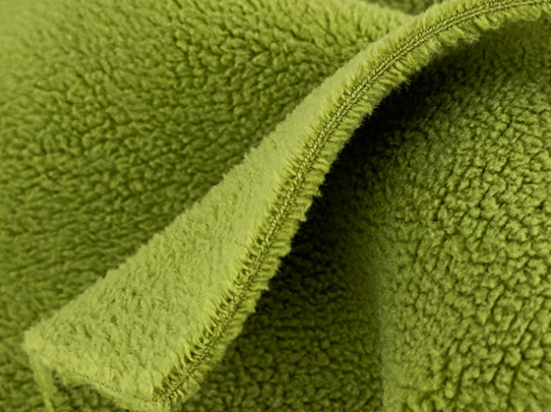
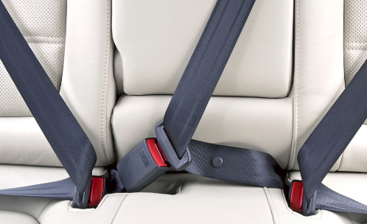
Plastic Bottles - #1 Plastic
Recycled plastic beverage bottles (“#1 Plastic”) is one of the most commonly recycled plastics and often turned into into new bottles, food containers, clothing fibers, carpeting, and packaging materials due to its versatility.
=
New plastic bottles
Takeout containers
Carpet
Backpacks
Plastic beverage bottles (#1 Plastic)
Sleeping bag
Seatbelts
Polar fleece fabric

Slide 11
Plastic Bottles - #2 Plastic
Large household plastic bottles like milk jugs and laundry detergent (#2 Plastic) are often turned into products like new containers, plastic lumber, piping, outdoor furniture and toys due to its durability.
=
New plastic jugs
Plastic Lumber
Playsets
Plastic beverage jugs/ Laundry detergent bottles (#2 Plastic)
Containers
Frisbees
Stadium seats
Buckets

Slide 12
Thank You

